Slide 1
APPLIED PREDICTIVE ANALYTICS
CASE STUDY
Topic : Uber Fare Prediction Using Predictive Analytics
Presented by : S.Madhuchandana(160124771016)
S.Lavanya(160124771022) T.Madhuri(160124771025)

Slide 2
Problem:
Uber needs to estimate the fare of a trip accurately based on factors such as distance, pickup/drop-off location and time.
Data used
Structured CSV Data
Main Data Used:
Pickup & drop-off location (Latitude/Longitude)
Trip distance
Date & Time
Ride status
Fare amount
Payment method
Target Variable: fare_amount
How Predictive Analytics Helps:
Predicts trip fare
Identifies factors affecting fare
Helps provide accurate fare estimates
Supports better pricing decisions
Improves customer transparency
Helps Uber analyze fare patterns

Slide 3
PREDICTION MADE:
The Random Forest Regression model predicts the fare amount of an Uber trip based on trip distance, pickup and drop-off locations, and time-related factors such as hour, day, month, and day of the week.
IMPACT ON BUSINESS:
The main business impact is improved fare estimation. By predicting Uber fares using trip distance, location, and time-related features, the company can provide more accurate price estimates to customers, improve pricing decisions, increase transparency, and support better revenue planning.

Slide 4
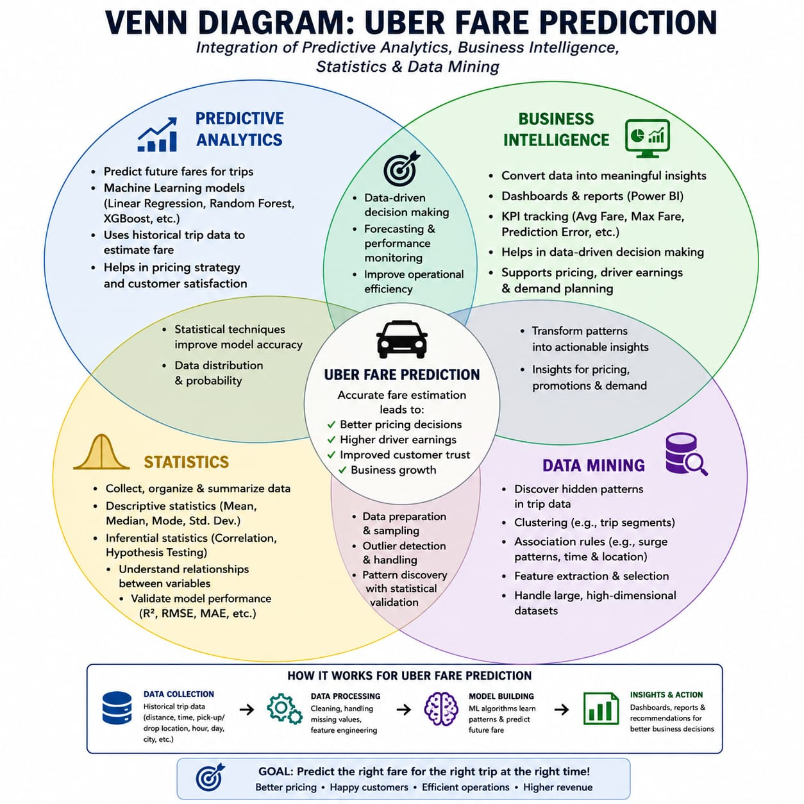

Slide 5
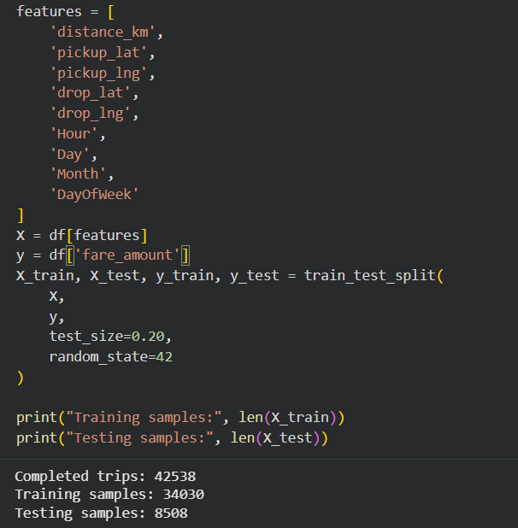
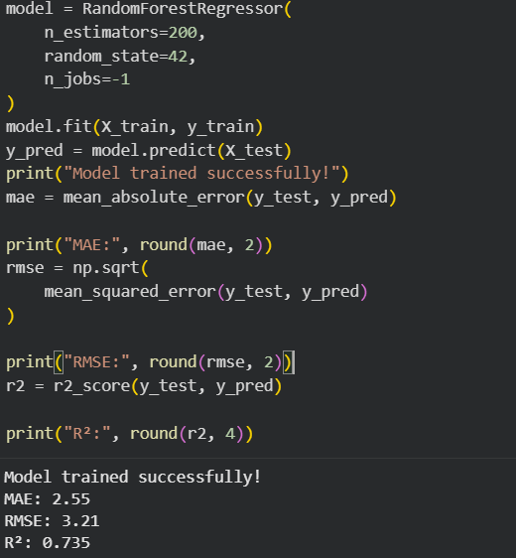

Slide 6
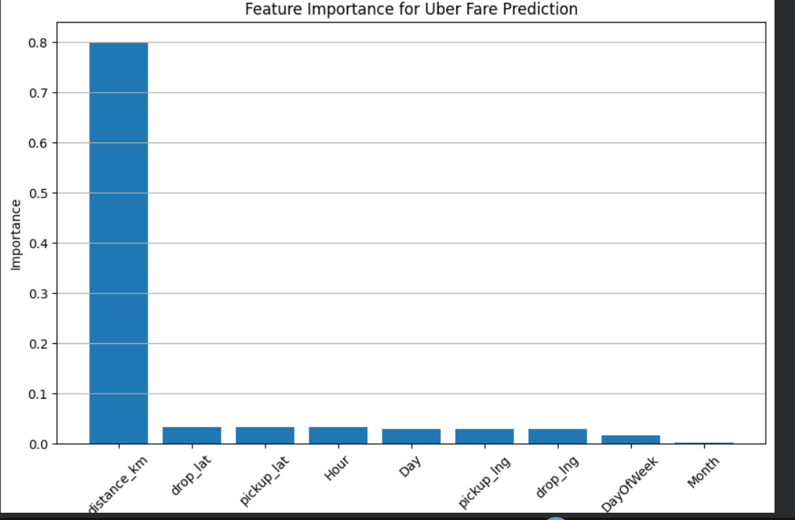

Slide 7
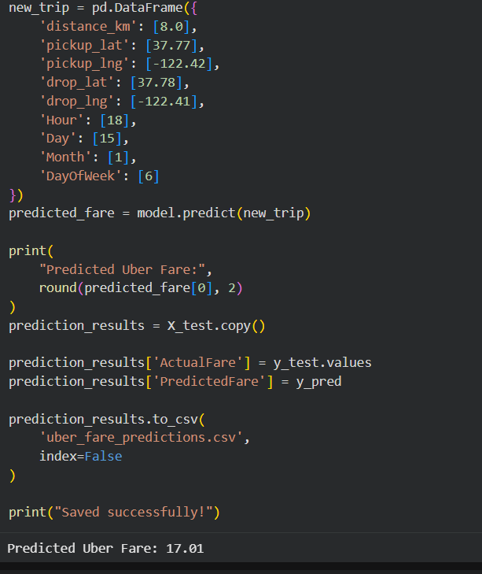

Slide 8
